Slide 1
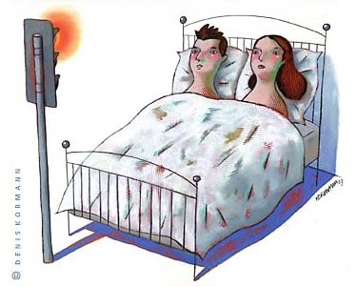
Contraception

Slide 2
Learning Outcomes
Give a method of contraception for each of the following types.
  Hormonal
  Barrier
  Chemical:

Slide 3
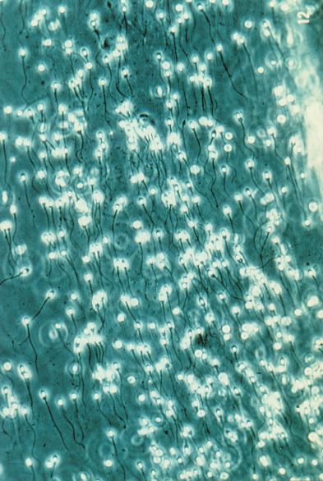
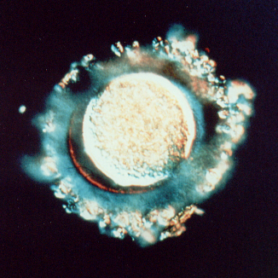
Fertilisation in Humans
To put it simply, it’s an “egg and sperm race”…
Egg
Sperm

Slide 4
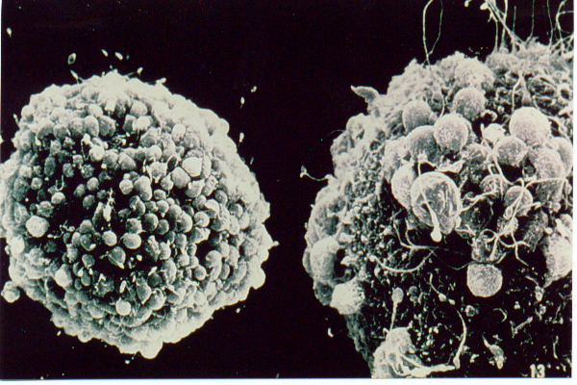
Fertilisation

Slide 5

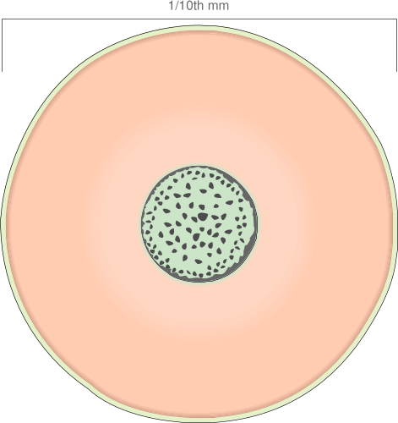
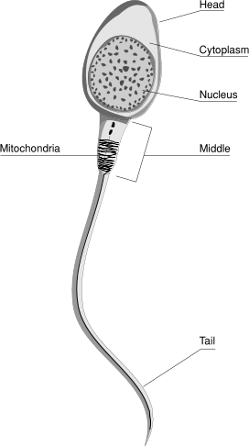
Eggs and sperm
The ______ cell is specialised in two ways:
Head packed with “enzymes” to ______ its way through the egg
Nucleus
The egg cell is basically an enlarged cell with massive _____ reserves
Strong tail for ________
Words – food, swimming, sperm, specialised, digest

Slide 6
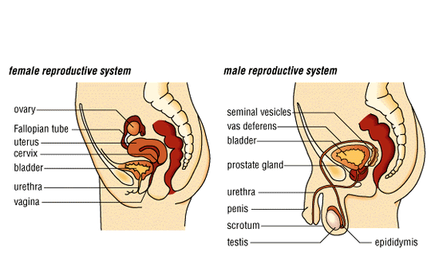
Male reproductive system

Slide 7
Female reproductive system

Slide 8
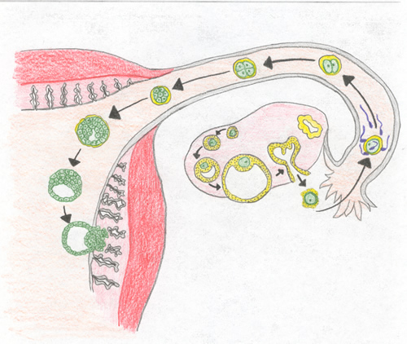
What is the first stage in becoming pregnant?
Fertilisation normally happens in the oviduct. The fertilised egg then passes along the oviduct into the uterus and IMPLANTS into the thick, soft lining.
While this is happening the cell begins to divide. 2 then 4 then 8 ….. cells
FERTILISATION

Slide 9
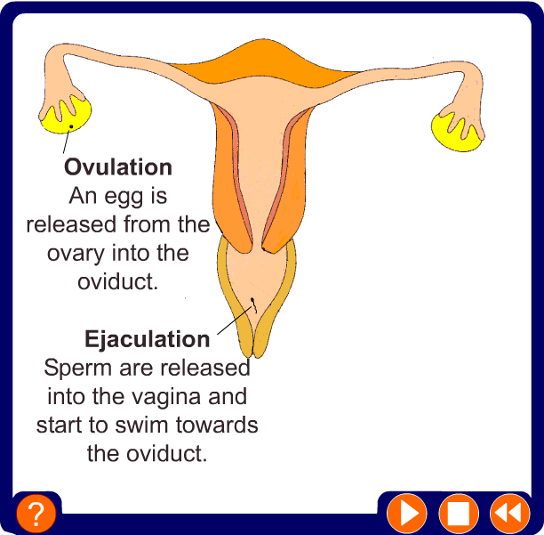
Fertilization and implantation

Slide 10


Slide 11
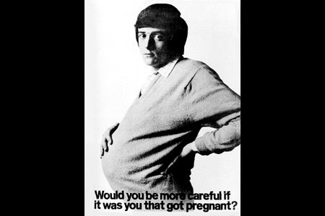

Slide 12
Teens & Pregnancy
1 million teens became pregnant in 2000
512,000 of these teens gave birth
6 of 10 U.S. pregnancies are unplanned
Most teens do not plan to have sex the first time forget to use a birth control method

Slide 13
Estimated Annual Cases of STD’s
(source: WHO)
333 million worldwide
15.3 million in U.S.

Slide 14
Estimated Annual Cases of STDs, U.S.
(American Social Health Association, Dec 1998, “STD’s: How many at at What Cost?”)
Human Papilloma Virus 5,500,000
Tichomoniasis 5,000,000
Chlamydia 3,000,000
Herpes 1,000,000
Gonorrhea 650,000
Hepatitis B 77,000
Syphilis 70,000
HIV 20,000
total 15,317,000
Notes:
Sexually transmitted diseases are diseases you can get by having sex – vaginal, oral, or anal – with someone who is already infected. STDs are caused by bacteria or viruses that are spread through blood, semen and vaginal fluids. Some STDs, like herpes and genital warts, are also spread simply by touching infected skin. If a woman is pregnant and has an STD, she and her developing baby may both be affected. Anyone who has sex can get an STD Infections in neonates are typically severe. Anyone who has sex can get an STD.
Most Americans are aware of HIV infection and AIDS, the most deadly of all STDs. But, for much of society, the other serious risks related to unsafe sexual behaviors may have been forgotten. There are over 20 diseases that are transmitted sexually. Many have serious and costly consequences. Some of the most common and serious STDs are listed.
The spectrum of health consequences ranges from mild acute illness to serious long-term complications such as gynecological problems and liver cancers, as well as other reproductive health problems.

Slide 15



Abstinence
Only 100% method of birth control
Abstinence is when partners do not engage in sexual intercourse
Communication between partners is important for those practicing abstinence to be successful

Slide 16

Reasons for abstaining
Moral or religious values
Personal beliefs
Medical reasons
Not feeling ready for an emotional, intimate relationship
Future plans

Slide 17

Types of Birth Control
Hormonal
Barrier
Chemical
IUD
Methods based on information
Permanent sterilization
R

Slide 18
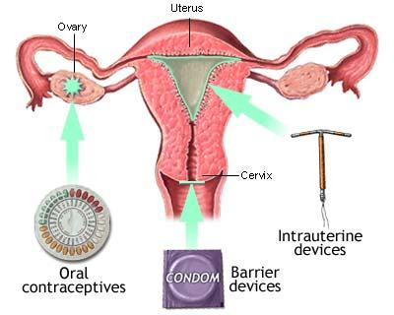

Slide 19
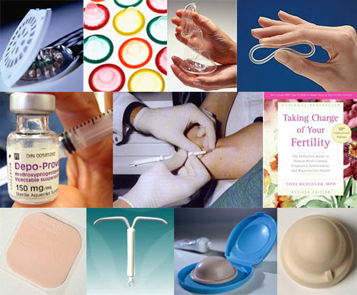

Slide 20
1. Hormonal Methods
Oral Contraceptives
(Birth Control Pill)
Injections (Depo-Provera)
Implants (Norplant I & II)

Slide 21
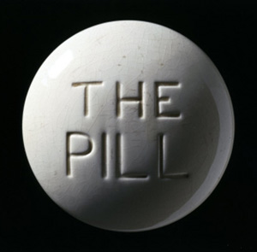
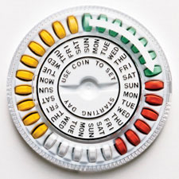
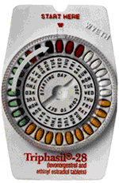
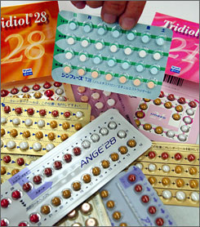
Birth Control Pills
Pills can be taken to prevent pregnancy
Pills are safe and effective when taken properly
Pills are over 99% effective
Women must have a pap smear to get a prescription for birth control pills
Pills DO NOT prevent STD’s

Slide 22
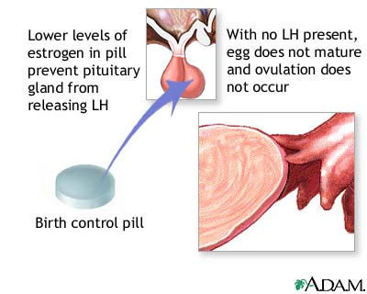
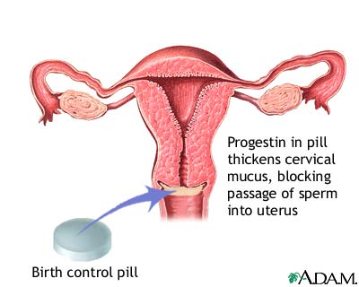
How does the pill work?
Stops ovulation
Thins uterine lining
Thickens cervical mucus

Slide 23
Positive Benefits of Birth Control Pills
  Prevents pregnancy
  Eases menstrual cramps
  Shortens period
  Regulates period
  Decreases incidence of ovarian cysts
  Prevents ovarian and uterine cancer
  Decreases acne
Side-effects
Breast tenderness
Nausea
Increase in headaches
Moodiness
Weight change
Spotting

Slide 24
Taking the Pill
Once a day at the same time everyday
Use condoms for first month
Use condoms when on antibiotics
Use condoms for 1 week if you miss a pill or take one late
The pill offers no protection from STD’s

Slide 25
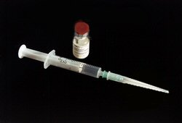
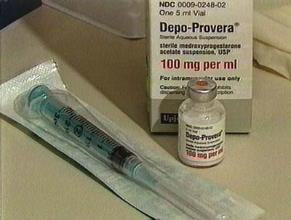
Depo-Provera
Birth control shot given once every three months to prevent pregnancy
99.7% effective preventing pregnancy
No daily pills to remember

Slide 26
How does the shot work?
The same way as the Pill
Stops ovulation
Stops menstrual cycles
Thickens cervical mucus

Slide 27
SIDE EFFECTS
Extremely irregular menstrual bleeding and spotting for 3-6 months!
NO PERIOD after 3-6 months
Weight change
Breast tenderness
Mood change
*NOT EVERY WOMAN HAS SIDE-EFFECTS!

Slide 28
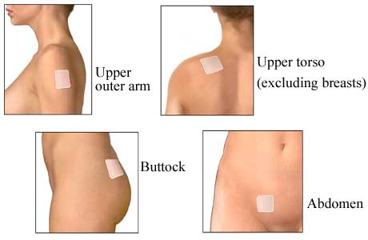
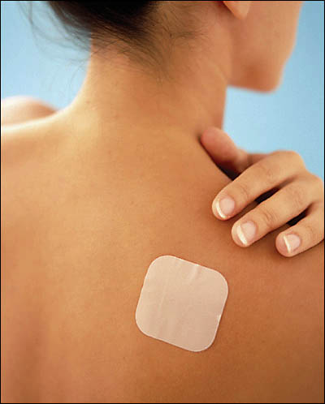
The Patch

Slide 29
IMPLANTS
Implants are placed in the body filled with hormone that prevents pregnancy
Physically inserted in simple 15 minute outpatient procedure
Plastic capsules the size of paper matchsticks inserted under the skin in the arm
99.95% effectiveness rate

Slide 30
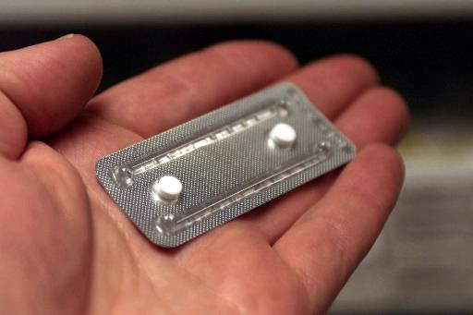
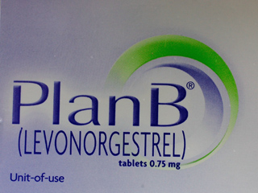

Emergency contraception pills can reduce the chance of a pregnancy by 75% if taken within 72 hours of unprotected sex!
Emergency Contraception

Slide 31
Emergency Contraception (ECP)
Must be taken within 72 hours of the act of unprotected intercourse or failure of contraception method
Must receive ECP from a physician
75 – 84% effective in reducing pregnancy

Slide 32
Emergency Contraception (ECP)
Floods the ovaries with high amount of hormone and prevents ovulation
Alters the environment of the uterus, making it disruptive to the egg and sperm
Two sets of pills taken exactly 12 hours apart

Slide 33
2. BARRIER METHODS
Male Condom
Female Condom
Diaphragm
Cervical Cap

Slide 34
BARRIER METHOD
Prevents pregnancy blocks the egg and sperm from meeting
Barrier methods have higher failure rates than hormonal methods due to design and human error

Slide 35
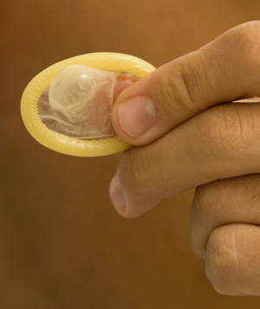
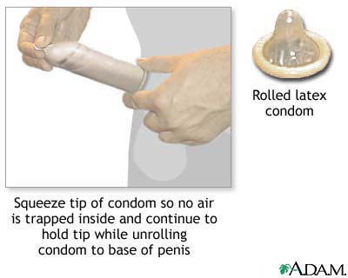
MALE CONDOM
Most common and effective barrier method when used properly
Latex and Polyurethane should only be used in the prevention of pregnancy and spread of STD’s (including HIV)

Slide 36

MALE CONDOM
Perfect effectiveness rate = 97%
Typical effectiveness rate = 88%
Latex and polyurethane condoms are available
Combining condoms with spermicides raises effectiveness levels to 99%

Slide 37
FEMALE CONDOM
Made as an alternative to male condoms
Polyurethane
Physically inserted in the vagina
Perfect rate = 95%
Typical rate = 79%
Woman can use female condom if partner refuses

Slide 38
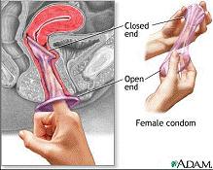
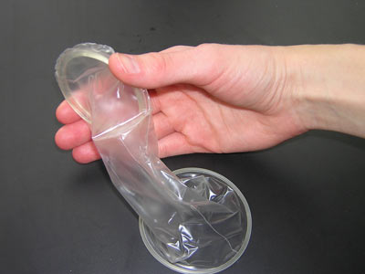
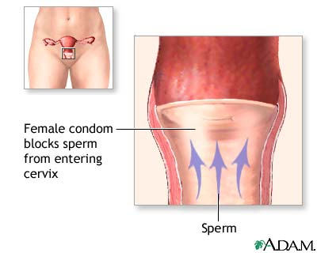
Reality ™ : The Female Condom
The female condom is a lubricated polyurethane sheath, similar in appearance to a male condom. It is inserted into the vagina. The closed end covers the cervix. Like the male condom, it is intended for one-time use and then discarded.
The sponge is inserted by the woman into the vagina and covers the cervix blocking sperm from entering the cervix. The sponge also contains a spermicide that kills sperm. It is available without a prescription.

Slide 39
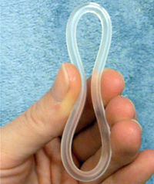
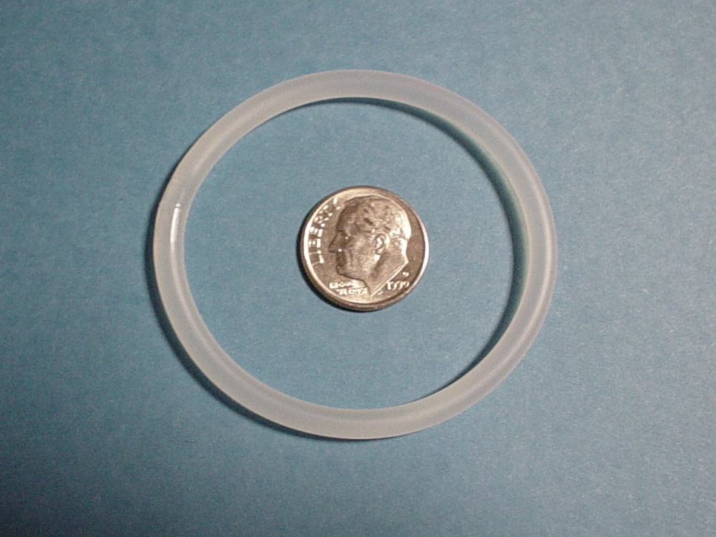
Vaginal Ring (NuvaRing)
95-99% Effective A new ring is inserted into the vagina each month
Does not require a "fitting" by a health care provider, does not require spermicide, can make periods more regular and less painful, no pill to take daily, ability to become pregnant returns quickly when use is stopped.
NuvaRing is a flexible plastic (ethylene-vinyl acetate copolymer) ring that releases a low dose of a progestin and an estrogen over 3 weeks.

Slide 40
DIAPRAGHM
Perfect Effectiveness Rate = 94%
Typical Effectiveness Rate = 80%
Latex barrier placed inside vagina during intercourse
Fitted by physician
Spermicidal jelly before insertion
Inserted up to 18 hours before intercourse and can be left in for a total of 24 hours

Slide 41
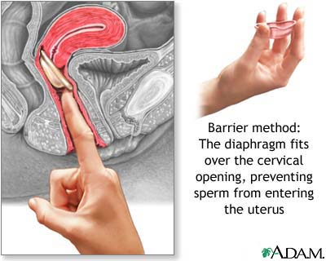
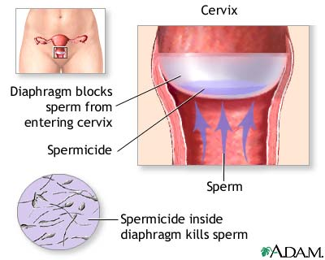
DIAPHRAGM
The diaphragm is a flexible rubber cup that is filled with spermicide and self-inserted over the cervix prior to intercourse. The device is left in place several hours after intercourse. The diaphragm is a prescribed device fitted by a health care professional and is more expensive than other barrier methods, such as condoms

Slide 42
CERVICAL CAP
Latex barrier inserted in vagina before intercourse
“Caps” around cervix with suction
Fill with spermicidal jelly prior to use
Can be left in body for up to a total of 48 hours
Must be left in place six hours after sexual intercourse
Perfect effectiveness rate = 91%
Typical effectiveness rate = 80%

Slide 43
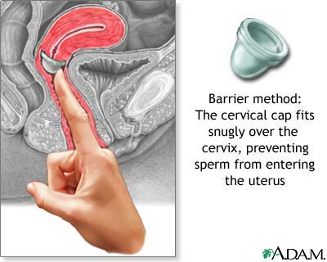
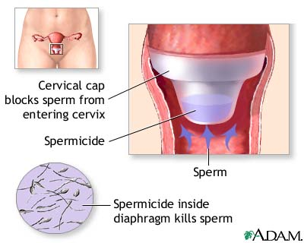
Cervical Cap
The cervical cap is a flexible rubber cup-like device that is filled with spermicide and self-inserted over the cervix prior to intercourse. The device is left in place several hours after intercourse. The cap is a prescribed device fitted by a health care professional and can be more expensive than other barrier methods, such as condoms.

Slide 44
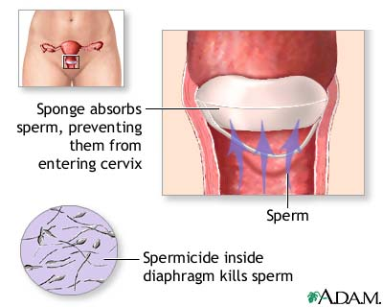
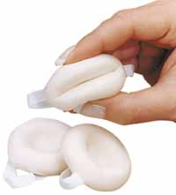
Sponge
The sponge is inserted by the woman into the vagina and covers the cervix blocking sperm from entering the cervix. The sponge also contains a spermicide that kills sperm. It is available without a prescription

Slide 45
3. Chemical Methods
Spermicides

Slide 46
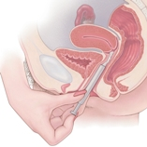
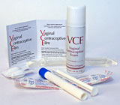
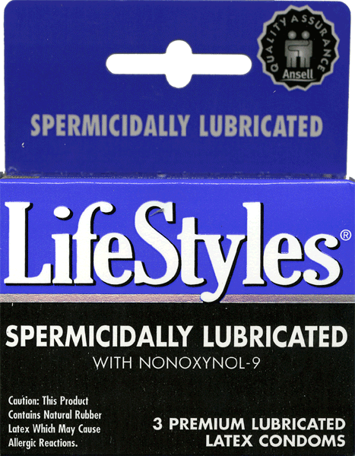
SPERMICIDES
Chemicals kill sperm in the vagina
Different forms:
-Jelly -Film
-Foam -Suppository
Some work instantly, others require pre-insertion
Only 76% effective (used alone), should be used in combination with another method i.e., condoms

Slide 47
STERILIZATION
Procedure performed on a man or a woman permanently sterilizes
Female = Tubal Ligation
Male = Vasectomy

Slide 48
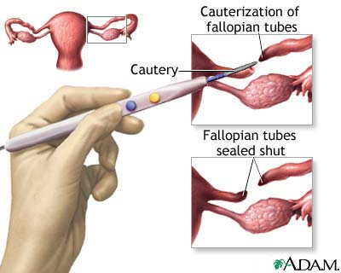
TUBAL LIGATION
Surgical procedure performed on a woman
Fallopian tubes are cut, tied, cauterized, prevents eggs from reaching sperm
Failure rates vary by procedure, from 0.8%-3.7%
May experience heavier periods
Surgical sterilization which permanently prevents the transport of the egg to the uterus by means of sealing the fallopian tubes is called tubal ligation, commonly called "having one's tubes tied." This operation can be performed laparoscopically or in conjunction with a Cesarean section, after the baby is delivered. Tubal ligation is considered permanent, but surgical reversal can be performed in some cases

Slide 49
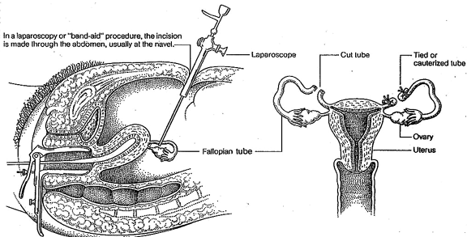
LAPAROSCOPY-’BAND-AID’ STERILIZATION

Slide 50
VASECTOMY
Male sterilization procedure
Ligation of Vas Deferens tube
No-scalpel technique available
Faster and easier recovery than a tubal ligation
Failure rate = 0.1%, more effective than female sterilization

Slide 51
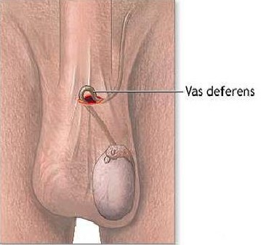
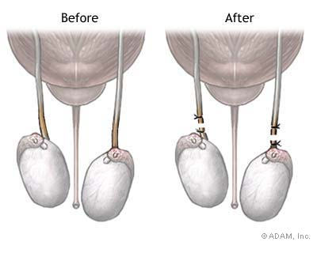
During a vasectomy (“cutting the vas”) a urologist cuts and ligates (ties off) the ductus deferens. Sperm are still produced but cannot exit the body. Sperm eventually deteriorate and are phagocytized. A man is sterile, but because testosterone is still produced he retains his sex drive and secondary sex characteristics.

Slide 52
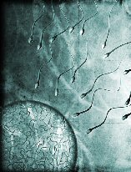

WITHDRAWAL
Removal of penis from the vagina before ejaculation occurs
NOT a sufficient method of birth control by itself
Effectiveness rate is 80% (very unpredictable in teens, wide variation)
1 of 5 women practicing withdrawal become pregnant
Very difficult for a male to ‘control’

Slide 53
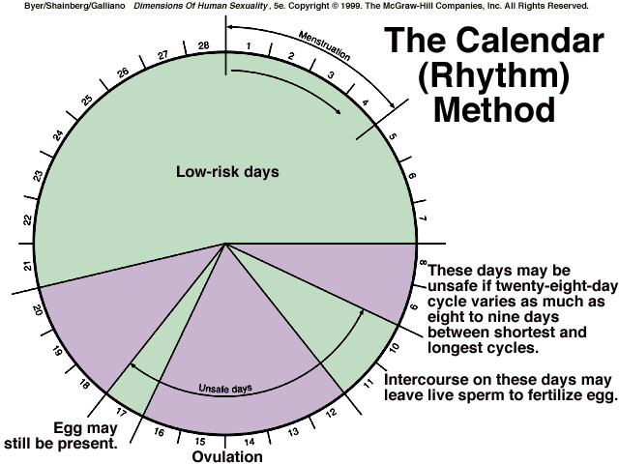

Slide 54
